Slide 1
Secure GeoPackage
Andreas Matheus
(Secure Dimensions)
OGC Disaster Pilot 2021

Slide 2
Overview
Motivation & Business Value
Demonstration Scenario
Demonstration Components Overview
Demonstration
PHASE I: Create a Secure GeoPackage for Features
PHASE II: Visualize the Secure GeoPackage with QGIS
PHASE III: Decrypt the GeoPackage Feature data
PHASE IV: Illustrate the power of the Key Management System
Conclusion & Future Work
Announcement

Slide 3
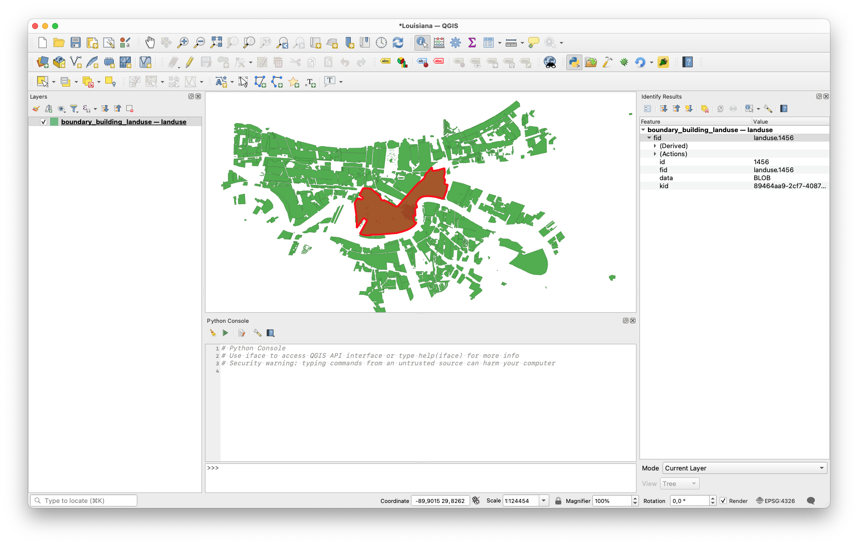
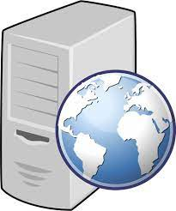
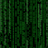
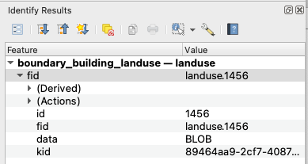
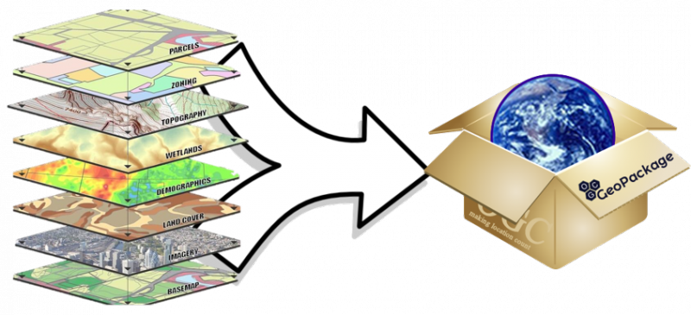

Secure GeoPackage – Motivation & Business Value
End-to-end encryption ensures GeoPackage content can only be used by the foreseen end-user under given conditions
Secure GeoPackage Service
(OGC WFS extension)
QGIS
Encrypted Content

Slide 4
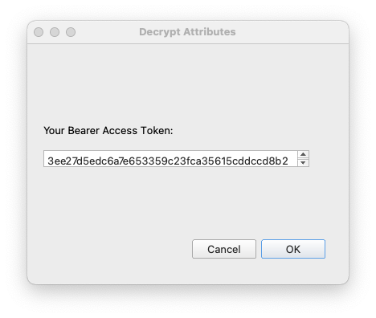
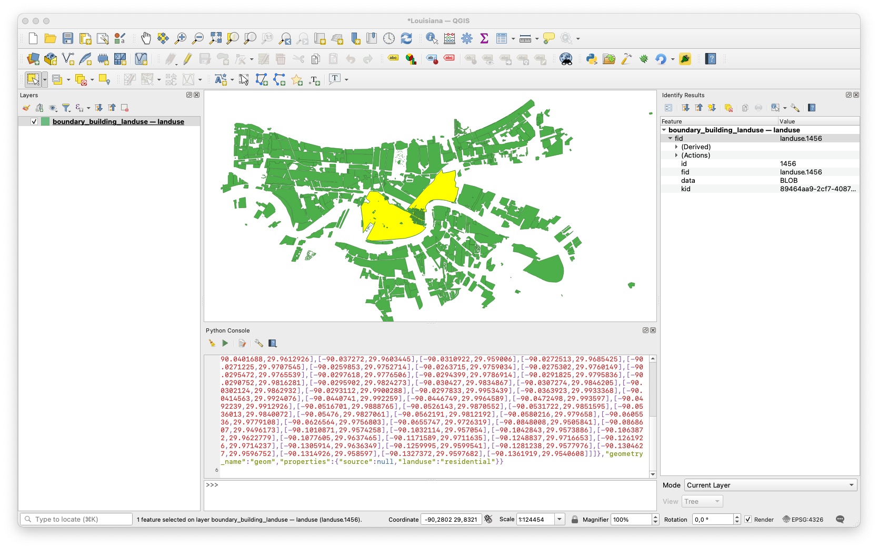

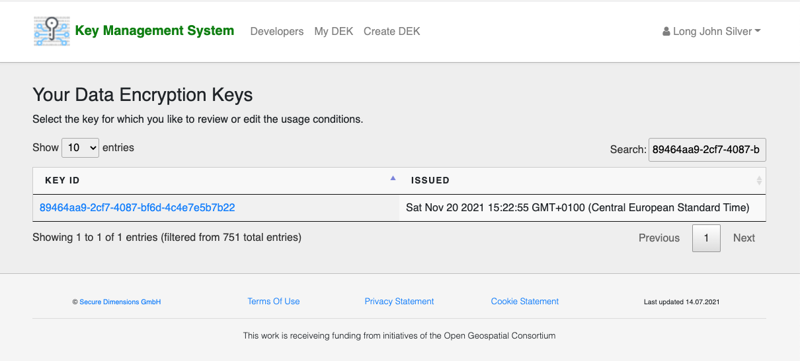

Secure GeoPackage – Motivation & Business Value
Decrypt Attributes
(Python Plugin)
Access Management

Slide 5
Secure GeoPackage – Motivation & Business Value
Disaster Management must be able to seamlessly use sensitive data
Secure GeoPackage ensures confidentiality of data by applying encryption (Secure GeoPackage Service – GeoServer Plugin)
User owns encryption key and can set access conditions (Key Management System)
Secure GeoPackage can be loaded with regular GeoPackage Reader software, but encrypted data renders as BLOB (QGIS)
Plugin required to decrypt data (Decrypt Attributes Plugin for QGIS)
Secure GeoPackage can be disseminated and loaded via existing software. Additional plugin can decrypt data. Key Management System ensures control over the decryption key.

Slide 6
Demonstration Scenario – Flooding in New Orleans
Disaster Manager (Andreas Matheus) creates Secure GeoPackage contain layers landuse, boundary and building
Secure GeoPackage is made available to First Responder users
Visualization of Secure GeoPackage via QGIS
Viewed (verified) by Disaster Manager
John Long Silver (before / after getting key access)
Any other user based on email address (Gmail or OGC)

Slide 7
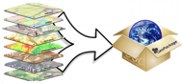
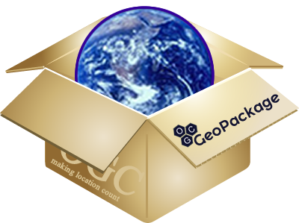
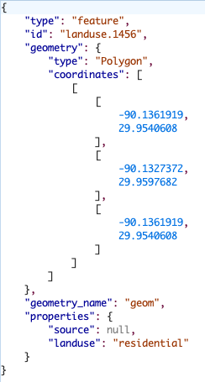
Component Introduction
Client App
Secure
GeoPackage Service
OGC WFS request
+ access token
User LJS
Secure GeoPackage
Key Management System
(in-kind contribution)
Key request
Key

Slide 8
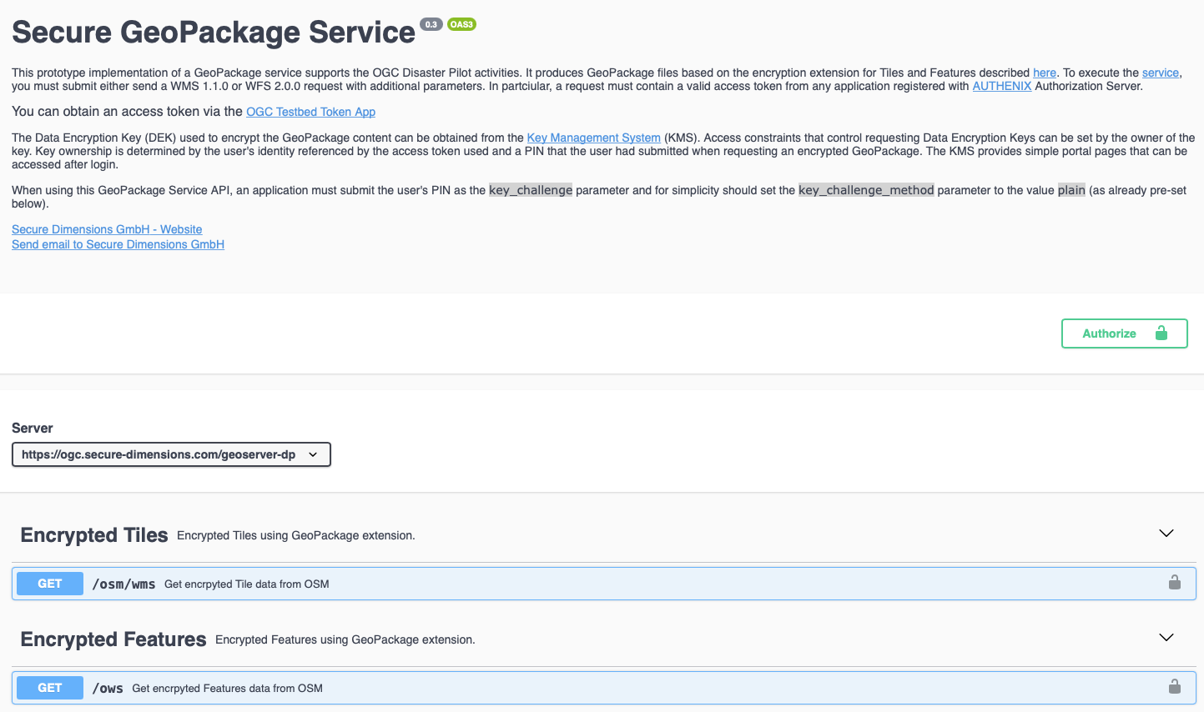
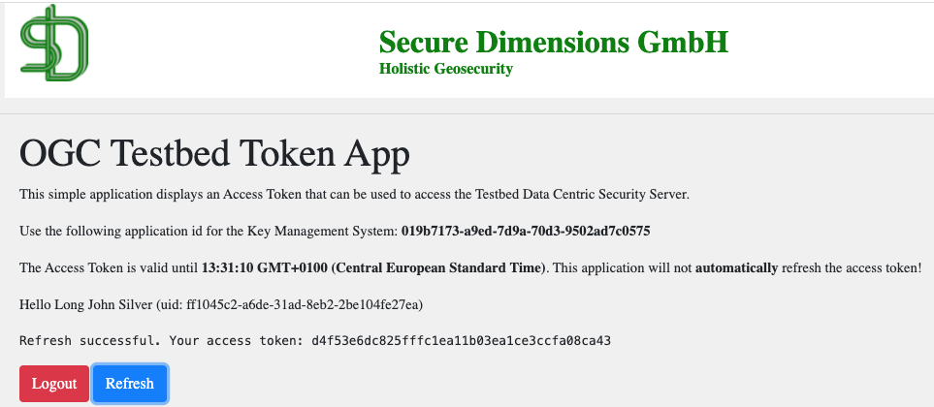
Demonstration – PHASE I
Generating a Secure GeoPackage
https://ogc.secure-dimensions.com/geoserver-dp/api/
1. Get a Bearer Access Token
2. Paste Bearer Access Token
3. Open Dialog

Slide 9
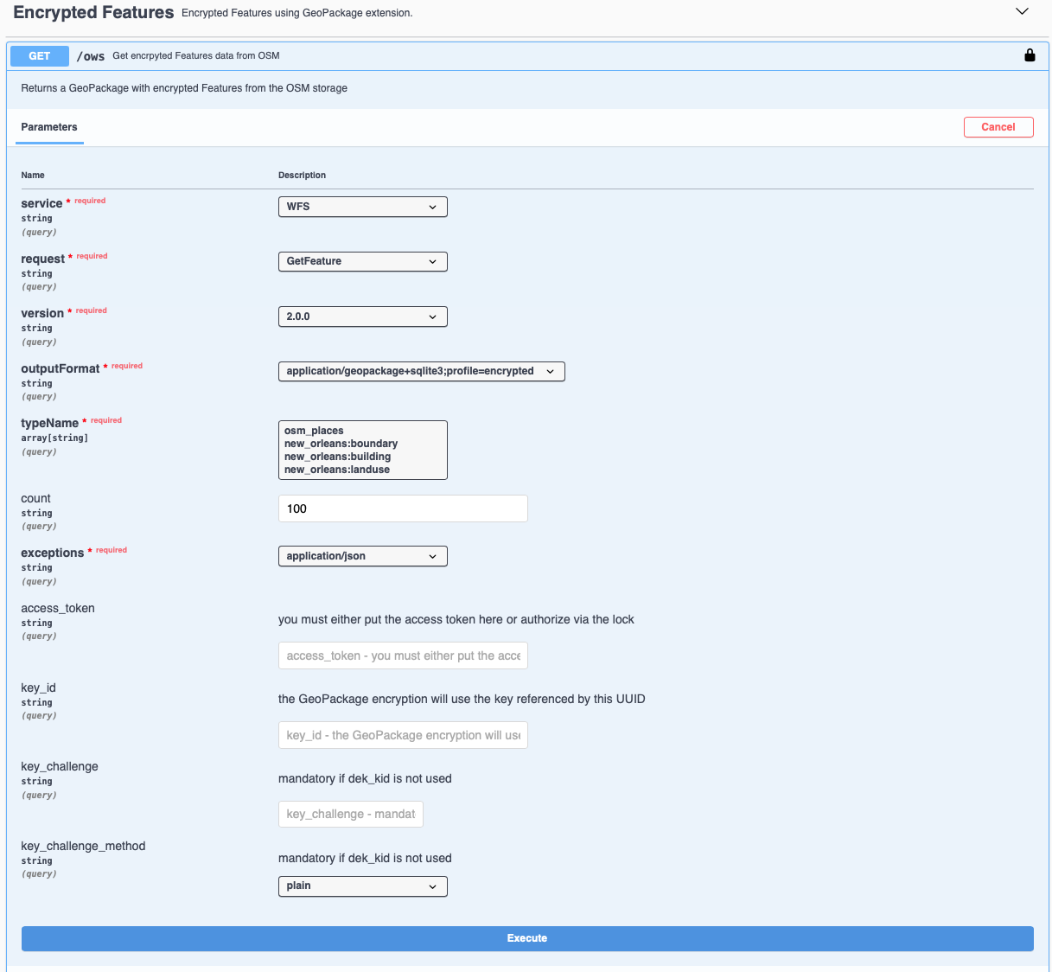
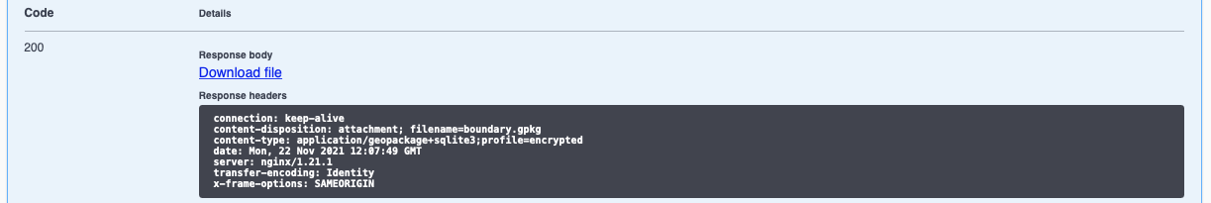
Demonstration – PHASE I
4. Wait and download Secure GeoPackage
Select layers
new_orleans:boundary
new_orleans:building
Adjust if you like
2. Provide a secret, e.g. 1234
3. Execute

Slide 10

Demonstration – PHASE II + III
1. Run as user Andreas Matheus
=> Success
2. Run as user Long John Silver
=> Error (not yet enabled)
3. Add user Long John Silver to the key via KMS (next slide)
4. Run as user Long John Silver
=> Success

Slide 11
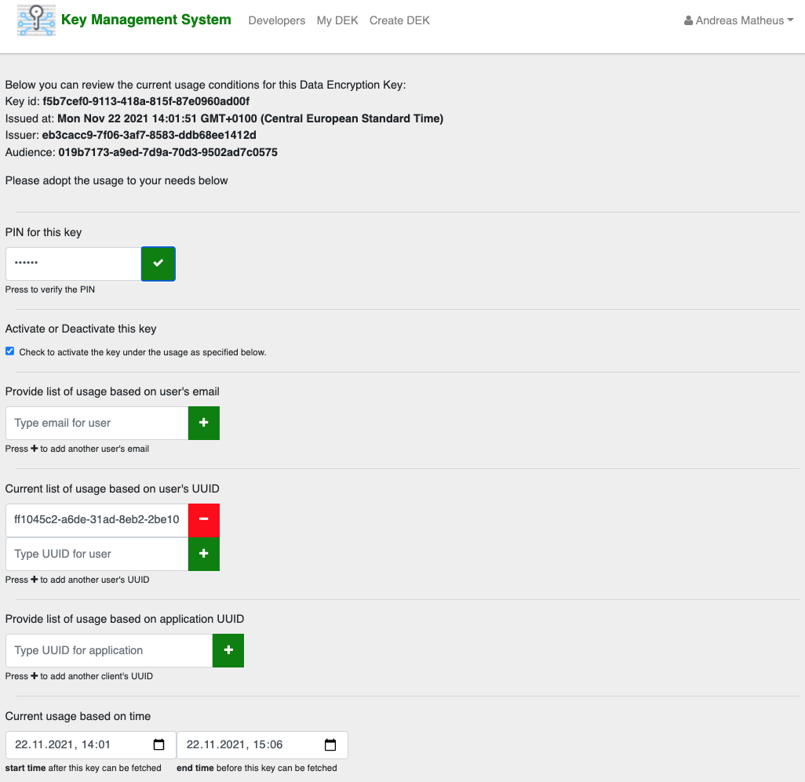
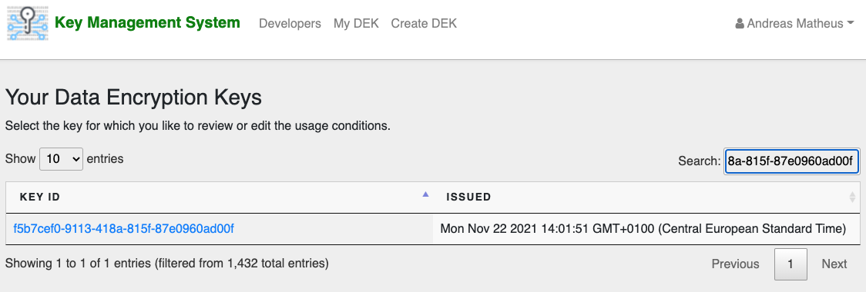
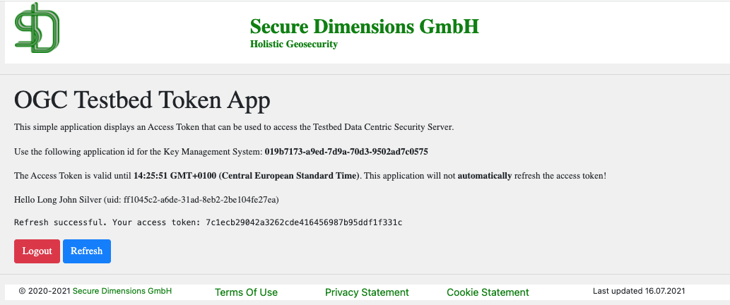
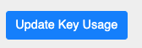
Demonstration – PHASE IV
Key Management System: https://ogc.secure-dimensions.com/kms
2. Add the user and adjust the end time
1. Find the key
1. Paste Key Id
3. You PIN
2. Follow link
4. Add user LJS
5. Adjust end time
6. Update

Slide 12
Conclusion & Future Work
Secure GeoPackage is an extension to GeoPackage that encrypts the data
GeoPackage Encryption Extension for Tiles
GeoPackage Encryption Extension for Features
Advantage over fully encrypted GeoPackage files: Secure GeoPackage can be opened with existing software (e.g. QGIS, SQLite Viewer)
Encryption of the data can take place individually per entry (feature or tile), for a group or all features
Access conditions to (decryption) key can be managed via Key Management System (add on to Client-Server architecture)
Future work
Standardize the GeoPackage Encryption Extension proposals
Standardize the API for the Key Management System

Slide 13
Announcement
OGC Developers Workshop
Wednesday 8th December 2021 from 11:00 EST to 19:00 EST Register at https://ogcmeet.org if you are interested!
Development of the QGIS Plugin “Decrypt Attributes” based on Python
Times in EST (New York time)
• 11:00 - 11:05 Welcome Remarks
• 11:05 - 11:10 Program for the day and Ways of Working
• 11:10 - 11:30 Introductory Presentation: GeoPackage with Encrypted Content, A New Approach - Dr. Andreas Matheus (Secure Dimensions GmbH)
• 11:30 - 11:50 Introductory Presentation: Datacubes Analytics through WCPS - Dr. Peter Baumann (rasdaman GmbH)
• 11:50 - 12:10 Introductory Presentation: Using the Metanorma Toolchain to Author OGC Standards - Ron Tse (Ribose)
• 12:10 - 12:20 Q & A
• 12:20 - 12:30 Break
• 12:30 - 14:30 Practical Work Block 1: GeoPackage with Encrypted Content, A New Approach - Dr. Andreas Matheus (Secure Dimensions GmbH)
• 14:30 - 15:30 Reserved for Plenary Activity
• 15:30 - 17:00 Practical work Block 2: Establishing Datacube analytics by writing WCPS queries - Dr. Peter Baumann (rasdaman GmbH)
• 17:00 - 18:30 Practical work Block 3: Using the Metanorma Toolchain to Author OGC Standards - Ron Tse (Ribose)
• 18:30 - 18:45 Discussion
• 18:45 - 19:00 Wrap up and Close

Slide 14
ThankYou!

Slide 15
Technical Backup

Slide 16
Installation of D111-3 - GeoPackage Encryption Service
Installation based on GeoServer 2.20 builds
Deploy GeoServer from 2.20 SNAPSHOT
https://build.geoserver.org/geoserver/2.20.x/geoserver-2.20.x-latest-war.zip
Compile GeoPackage Encryption plugin
$> git clone https://github.com/securedimensions/geoserver-geopackage-encryption-plugin.git (private repo for the moment)
$> cd geoserver-geopackage-encryption-plugin
$> mvn clean install dependency:copy-dependencies
$> ./createZIP.sh
Deploy GeoPackage Encryption plugin
$> cd <path to Tomcat webapps>/geoserver/WEB-INF/lib
$> unzip <path to directory>/geoserver-geopackage-encryption-plugin-1.0-SNAPSHOT.zip
$> touch ../web.xml

Slide 17



Interaction Overview (I/III)
Authorization Server
(in-kind contribution)
Register
App
User
Login
Access Token
validation
Login Federation
OGC API Request
+ access token
+ security parameters
DCS
GeoPackage Engine
Client App
GeoServer
Data
Features
Tiles
Health
GeoPackage with
encrypted features / tiles / health
register DEK
DEK kid
Request DEK
+ access token
Key Management System
(in-kind contribution)
DEK
DEK: Data Encryption Key

Slide 18
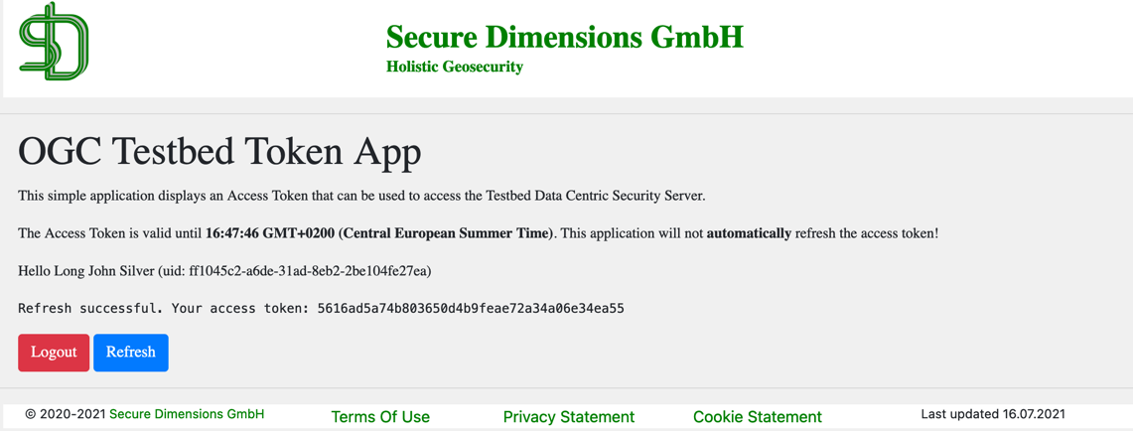
Fetching a Bearer Token
Use OGC Testbed Token App
https://ogc.secure-dimensions.com/dcs/token-app/

Slide 19
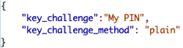
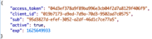
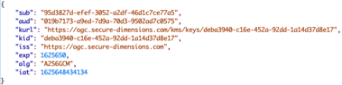
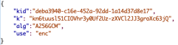
Interaction Overview (II/III)
Client App
DCS
GeoPackage Engine
OGC Request
+ access token
+ security parameters
User LJS
DEK kid
register DEK
Key Management System
(in-kind contribution)
Request DEK
+ access token
DEK
DEK: Data Encryption Key

Slide 20
Demo Client to fetch Encrypted GeoPackage
https://ogc.secure-dimensions.com/geoserver-dp/api

Slide 21
Request GeoPackage with encrypted Features
Get GeoPackage Encryption Extension Features via OGC Web Feature Service 2.0
Set query string parameters
access_token=<your access token>
key_challenge=<a secret pin or password to modify key usage>
key_challenge_method=plain
f=application/geopackage+sqlite3;profile=encrypted
wget 'https://ogc.secure-dimensions.com/geoserver-dp/tiger/ows?service=WFS&version=2.0.0&request=GetFeature&typeName=tiger%3Apoi,tiger%3Atiger_roads&count=50&outputFormat=application%2Fgeopackage%2Bsqlite3%3Bprofile%3Dencrypted&access_token=<your access token>&key_challenge=<your pin or secret>&key_challenge_method=plain' -O features.enc.gpkg

Slide 22
Exploring content
Use SQLite3 command to extract encrypted feature data
$> sqlite3 features.enc.gpkg
sqlite> SELECT table_name from gpkg_extensions WHERE extension_name='sd_encrypted_features' AND column_name IS NULL AND table_name!='gpkg_ext_keys';
<DCS table name>
sqlite> SELECT writefile('feature.1.bin', data) FROM <DCS table name> LIMIT 1;
sqlite> .quit
Use SQLite3 command to extract DEK information
$> sqlite3 features.enc.gpkg
sqlite> SELECT table_name from gpkg_extensions WHERE extension_name='sd_encrypted_features' AND column_name IS NULL AND table_name!='gpkg_ext_keys';
<DCS table name>
sqlite> .output dek.jws
sqlite> SELECT gpkg_ext_keys.data FROM gpkg_ext_keys INNER JOIN <DCS table name> ON gpkg_ext_keys.id=<DCS table name>.key_id LIMIT 1;
sqlite> .quit
Extract DEK id from JWK
cut -d '.' -f 2 dek.jws | base64 -d | sed 's/\\//g' | sed -e 's/$/}/g' | jq -r '.kid'

Slide 23
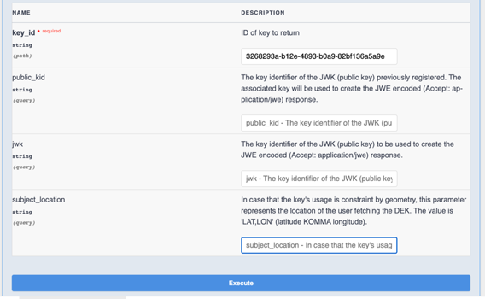
Fetch DEK in JSON Format
Use the DEK API from the Key Management System
https://ogc.secure-dimensions.com/kms/developers#/DEK/getKeyById
{ "kid": "3268293a-b12e-4893-b0a9-82bf136a5a9e", "alg": "A128CBC-HS256", "kty": "oct", "k": "SOvwY3ZghBXEkB9DxpYZN7ZNOJslKrTJjlno2j0rYFs", "issuer": "4bf1cb21-9ff7-f443-f736-70781d89d413", "key_challenge": "secret", "key_challenge_method": "plain", "expires": 1631094341, "issued_at": 1631093342, "aud": "019b7173-a9ed-7d9a-70d3-9502ad7c0575", "sub": "ff1045c2-a6de-31ad-8eb2-2be104fe27ea" }
Store key as dek.json

Slide 24
Fetch DEK in JWT or JWE Format
Use the DEK API from the Key Management System
https://ogc.secure-dimensions.com/kms/developers#/DEK/getKeyById
eyJhbGciOiJSU0ExXzUiLCJlbmMiOiJBMTI4Q0JDLUhTMjU2Iiwia2lkIjoiODkzZWYzYzgtYzI0OS00N2EyLTkxZTItMDAxYTBiMjAxNjQ3In0.ETooir0ZVpz3f2BTOEKTeFTYdwELilyHcaj3fAbsRfrMM9HhJ80WOZ-eQNYDTOhvnBtq0QB1FLG-vVHlg0c0wfG6D3xf9g7E4yquP7D2BuinlvqdzOXdcXdMrhBUVSULwhGJkhVUxYwr-0lYv7_syRA3C8ddchjpM5hkcZRXdYbcewpNjOp-QHvfao1hz5DuNXDJk6D3jj-m2hgSo9BoYUKNWp8ADFrLjhjlDuI5R1qvnCHDNoZubikXkGAgPVd45gAuIrVdT07w8-jwml5-wOgmH-0rbCvXB9fKFGwTu2jE5JxQNTt7uNwpwAKOZga3oJKSDXdIX9o3m3Nl9WPy2A.WRcPTqAtq_6lxor4Tw_n_w.BauYMxeaHDao-5mjC_EFla0tFGLqRGjmkFM2AgdogyN4ZczBwa823Ov5PUd2NfqSwcjYHBUEXr-qkudCQKdPZQD4CLcF7rGxgP6FU1Gnsrkpy1LWZZOnfOsmjKJbkXpNaXHdjxIr_DZOU05qu_k1TQ5bs0tBJrLuOjhG_KjCQGogsn2VTC__qRkLYdsYqj4m1KHavNcjczVndFoBT2Jbrg8ntw0tuKQUBDO6TDreOJhUxq0yrrnXkEBPB5YvjcoUx7d5Id5Rr-GYqArFFUK9pt2HwNwbVYPOeTHqkfBxjcUmJ9GjI1xs_74yhlPOcwaF7Z8En8YkpWdxqLb06F3TQzuI8XwLz2LztIzs5kYh-lZQZsRCnBSDws_43ssgjQ_SVBvp5fDCUZLTESx2HvJGesANPDHpnOw3_YuC4GjNFfSiMAMi4mo_gB8WEEP3dR1zbzl2ebQem1PQTU77F_-f1OTab7sx0drc3tP3-55ybTPL1SX9QVflXHHxJAHDep5cHIAL2xD65xVqn-ywQduwW7nVSv9w9D5V_ZxYV4FPlxxmVEz21Yyi9XP_4NweW_0F9o-6cG-9N9K9088KEk5NbGSZbLa78uUyClWbdq2hujuSQd_7qxJUqfbacgosKln4B4g05FmW64wCwaTDWXKCWOCrrb5ZWKTGf_Gpa2W9ETVZYX-SNmvIrGx490WB5Mc0zDOB8P2epYTYpoZ-b57loHfFXvEoGvKpRNkwz8CMhe2bdMyEQm-Gtrud8iKAfniHxHUgcO5np8Z_DQiZrLLyA8z1GLLS2ATftxD3dKj8lsd9nvsZaFXYpG_iA-QSykBul32TycJz1gi3ITNnqJFKr7OVZnsF_deAhY0OE4WZ8gdGjmnHeu9_Y5q1Jj8gJ64ZXh96LTt7EtQ6viqB2QnZBIZl8QKte7oh1E43Zm9C-e04Flz6wV7eomck9hyawl9S3ZjMTQTqAydOKAg817i3jJMA-aVxT0td-34f8SGq_KQOVzoy0LlAJY0e3gYuwo8E9RX2_aekNj4I_rDTSrWRAOIclc0H3knXn5OYUDVcV7xOUYeRoKt9Thl1jhSBJfIkbHLJ1ZtMSq7BJeZyMasw1yMA_ILcr8FWrjfhffzqB5pNrk_joVCoGUVFVECpdlpl1_l3Fc5IBTLvZoYzLh6QyQ.bo-lIcK_h8sasggbP1ytYg
{ "iss": "https://ogc.secure-dimensions.com/kms", "aud": "019b7173-a9ed-7d9a-70d3-9502ad7c0575", "iat": 1633621901, "nbf": 1633622397, "exp": 1633625460, "kid": "c4803604-b74b-4b57-a910-09bf00a8c477", "alg": "A128GCM", "k": "hzi3dDxmEoIBnP8wBJ_YHg" }

Slide 25
Decrypt the feature
Use any SDK to decrypt the feature.1.bin
The data starts with the IV (16 Bytes) immediately followed by the encrytped data
Use example program
$> java -jar BinaryDecrypt.jar dek.json feature.1.bin feature.1.json

Slide 26
Request GeoPackage with encrypted Tiles
Get Encrypted GeoPackage Tiles via OGC Web Map Service 1.1.0
Set query string parameters
access_token=<your access token>
key_challenge=<a secret pin or password to modify key usage>
key_challenge_method=plain
f=application/geopackage+sqlite3;profile=encrypted
wget 'https://ogc.secure-dimensions.com/geoserver-dp/tiger/wms?service=WMS&version=1.1.0&request=GetMap&layers=tiger%3Apoi&bbox=-74.0118315772888%2C40.70754683896324%2C-74.00153046439813%2C40.719885123828675&width=641&height=768&srs=EPSG%3A4326&styles=&format=application/geopackage%2Bsqlite3;profile=encrypted&access_token=<your access token>&key_challenge=<your pin or secret>&key_challenge_method=plain' -O tiles.enc.gpkg

Slide 27
Exploring content
Use SQLite3 command to extract encrypted tile data
$> sqlite3 tiles.enc.gpkg
sqlite> SELECT table_name from gpkg_extensions WHERE extension_name='sd_encrypted_tiles' AND column_name IS NULL AND table_name!='gpkg_ext_keys';
<DCS table name>
sqlite> SELECT writefile('tile.1.bin', data) FROM <DCS table name> LIMIT 1;
sqlite> .quit
Use SQLite3 command to extract DEK information
$> sqlite3 tiles.enc.gpkg
sqlite> SELECT table_name from gpkg_extensions WHERE extension_name='sd_encrypted_tiles' AND column_name IS NULL AND table_name!='gpkg_ext_keys';
<DCS table name>
sqlite> .output dek.jws
sqlite> SELECT <DCS table name>.data FROM gpkg_ext_keys INNER JOIN <DCS table name> ON gpkg_ext_keys.id=<DCS table name>.key_id LIMIT 1;
sqlite> .quit
Extract DEK id from JWK
cut -d '.' -f 2 dek.jws | base64 -d | sed 's/\\//g' | sed -e 's/$/}/g’ | jq -r '.kid'

Slide 28
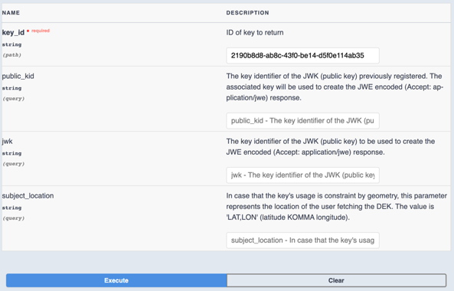
Fetch DEK
Use the DEK API from the Key Management System
https://ogc.secure-dimensions.com/kms/developers#/DEK/getKeyById
{ "kid": "2190b8d8-ab8c-43f0-be14-d5f0e114ab35", "alg": "A128GCM", "kty": "oct", "k": "lmTVTownEW9Ls7DFYB1Phw", "issuer": "4bf1cb21-9ff7-f443-f736-70781d89d413", "key_challenge": "secret", "key_challenge_method": "plain", "expires": 1631111665, "issued_at": 1631110666, "aud": "019b7173-a9ed-7d9a-70d3-9502ad7c0575", "sub": "ff1045c2-a6de-31ad-8eb2-2be104fe27ea" }
Store key as dek.json

Slide 29
Fetch DEK from KMS and decrypt the tile
Use your favorite SDK to write a program to decrypt the tile.1.bin
The data starts with the IV (16 Bytes) immediately followed by the encrytped data
Use example program
$> java -jar BinaryDecrypt.jar dek.json tile.1.bin tile.1.png

Slide 30
Good luck…

Slide 31
Additional Slides

Slide 32
Troubleshouting errors from KMS
I receive an error from the KMS: “stealing a key?”
This indicates that you’ve used different logins for fetching a Encrypted GeoPackage and the key from KMS
Correct the issue by logging into the KMS using the same account that you used to fetch the Encrypted GeoPackage and share the key with your identity that you have via the other login
Either by poviding the email or UUID from that account
I receive an error “time after not_after”
This indicates that the time window for fetching the key from KMS has passed.
Correct this by logging into the KMS and correct the “current usage based on time”
NOTE: When updating key usage, you must provide the <your pin or secret> that you submitted with the key_challenge parameter when requesting the Encrypted GeoPackage!!!
For further trouble shooting: Contact details are on last slide

Slide 33
Interaction Overview (III/III)
Client App
DCS
GeoPackage Engine
OGC API Request
+ access token
+ security parameters
User LJS
DEK kid
register DEK
Key Management System
(in-kind contribution)
Request DEK
+ access token
valid for 60 seconds
(online decryption of GeoPackage content)
DEK
DEK: Data Encryption Key

Slide 34

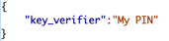

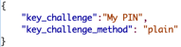
Key Management System Admin Function
Admin Client
Modify Usage of Key Request
+ kid
+ access token
+ security parameters
Key Management System
(in-kind contribution)
User LJS
Modify DEK Usage
User
Geographic extend
Application
Times of access
Proof of Key Ownership
is required
access token
key_verifier
Keys + Policies
Key
DEK: Data Encryption Key

Slide 35
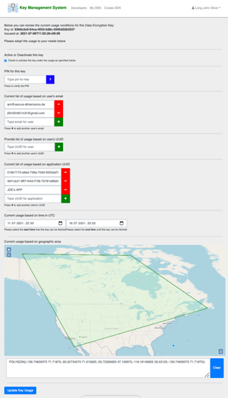
KMS Admin Portal – Review / Update Key Access
The key identifier that you review or for which you are making access condition changes.
An activated key can be fetched by applications to decrypt data under the conditions below.
This is the PIN that you selected when creating / uploading the key.
Condition 1a) This is the list of user email addresses that are able to fetch the key
Condition 1b) This is the list of user identifiers (UUID) that are able to fetch the key
Condition 2) This is the list of application identifiers (UUID) that are able to download the key
Condition 3) The date-time after which fetching of the key is possible
Condition 4) The date-time before which fetching of the key is possible
Condition 5)This is(are) the geographic area(s) that the user (the user’s mobile device) must be located to fetch the key. For the geographic condition, the GPS location sent by the trusted application must be within the specified polygon(s).
When an application requests to download a key, all conditions must be met.
Clearing the geographic area disables Condition 5).

Slide 36
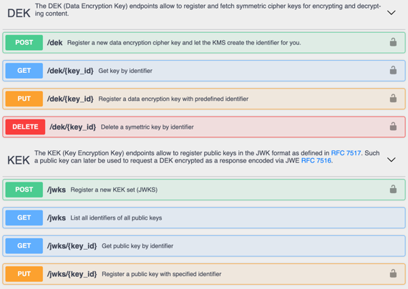
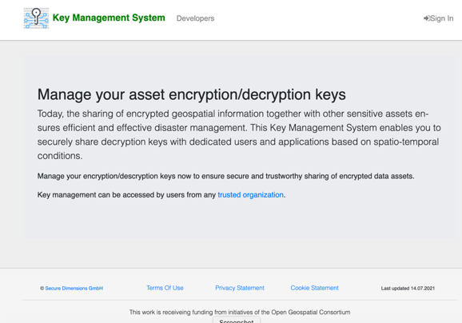
KMS Overview
Key Management System
API
Portal

Slide 37
Community
500+ International Members
110+ Member Meetings
60+ Alliance and Liaison partners
50+ Standards Working Groups
45+ Domain Working Groups
25+ Years of Not for Profit Work 10+ Regional and Country Forums
Dr. Andreas Matheus
Secure Dimensions
am@secure-dimensions.de
Innovation
120+ Innovation Initiatives
380+ Technical reports
Quarterly Tech Trends monitoring
Standards
65+ Adopted Standards
300+ products with 1000+ certified implementations
1,700,000+ Operational Data Sets Using OGC Standards
Contact info@ogc.org to schedule a meeting for an in-depth discussion with OGC staff and join our community today!
Notes:
If you have any questions, do not hesitate to reach out to OGC or schedule a follow-up. We’re working constantly to change the landscape of location information and want to help your organization get where it needs to go.

